Slide 1
Wind as a Geologic Agent
Lecture 3
collected by : Maher M Mahdi

Slide 2
Global wind system
Wind has been important agent in shaping the landscape at times when the continents were drier and windier places than they are today.
Wind is the movement of air, principally horizontal movement caused by:
Heating by the Sun.
Rotation of Earth on its axis.

Slide 3
The basic reason, the atmosphere is always in motion is that more of the Sun’s heat is received per unit of land surface near the equator than near the poles.
This unequal heating gives rise to convection currents.
The heated air near the equator becomes lighter, rises, and expands.

Slide 4
High up, the air spreads outward in the direction of both poles.
As it gradually cools, it becomes heavier, and sinks.
This cool, descending air flows back toward the equator completes a cycle of convection.

Slide 5
Wind Characteristics in arid Lands

Slide 6
wind can be an important agent of erosion and deposition in any climate, as long as sediment particles are loose and dry.
wind differs from running water in two ways:
because air is less dense than water, wind can erode only fine sediment - sand, silt and clay
wind is not confined to channels as running water is, so wind can have a widespread effect over vast areas

Slide 7
Faster the air flows, more erosion
Erodes more rapidly if wind blows constantly from one direction.

Slide 8
Geo - Aeolian processes in Arid Lands

Slide 9
(Aeolian process )
The common process in desert lands:
weathering
Wind erosion
transport
deposition
Occurs in dry regions, with little vegetation such as deserts and coastal landscapes

Slide 10
Weathering The breakdown of *rocks and *minerals and below the Earth’s surface by the action of physical and chemical processes. Essentially it is the response of Earth materials to the low pressures, low temperatures, and presence of air and water that characterize the near-surface environment.
Not as effective as in humid regions
Mechanical weathering produces unaltered rock and mineral fragments
Clay
Thin soils
Oxidized minerals

Slide 11
Wind Erosion
Two forms of wind erosion
The First: Deflation or desert pavement
The removal of material from a land surface by *aeolian processes. It is most effective where extensive unconsolidated materials are exposed,
*Removal of material by wind
* transport

Slide 12
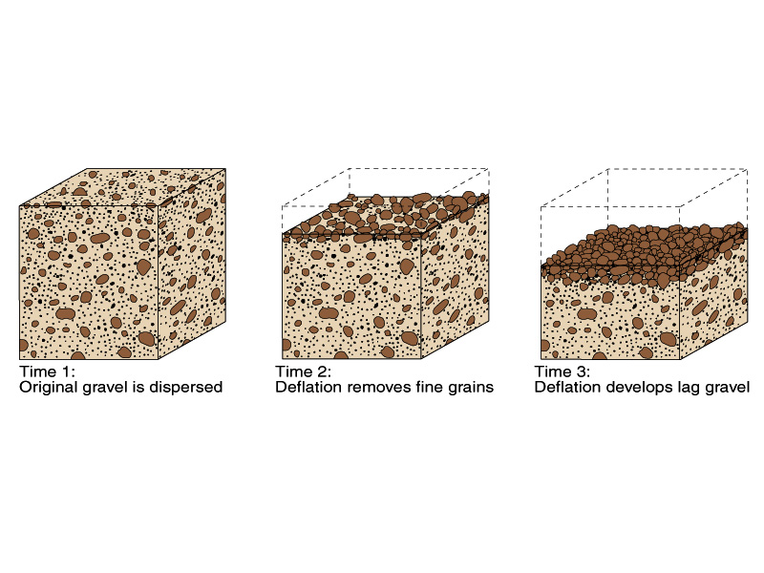
Deflation

Slide 14
The second: Abrasion ,

Slide 15
Abrasion results
Ventifacts or Dreikanters A pebble that has been faceted by the abrasive action of wind-blown sand and dust. Multiple faceting may reflect pebble movement as underlying sand is disturbed,rather than changes in wind direction. Each facet faces the direction of the abrading wind. A pebble with three facets (triangular facet) is called a ‘dreikanter’; one with one facet an ‘einkanter
Polishing,
Blowout - area deflated by wind
Streamlining (Yardangs)
On Mars, with billions of years of only wind erosion, wind has had much greater effects

Slide 16
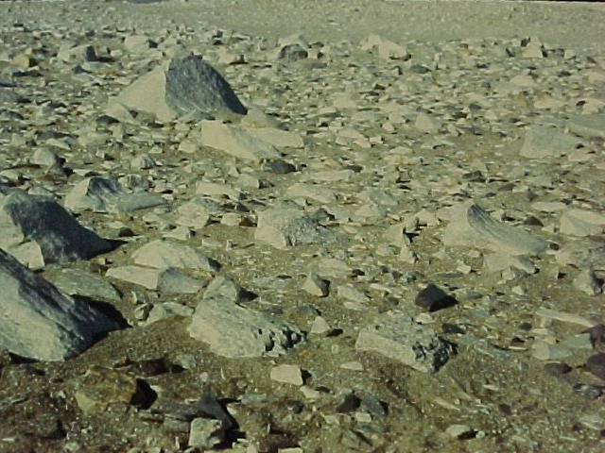
Ventifacts, Antarctica

Slide 17
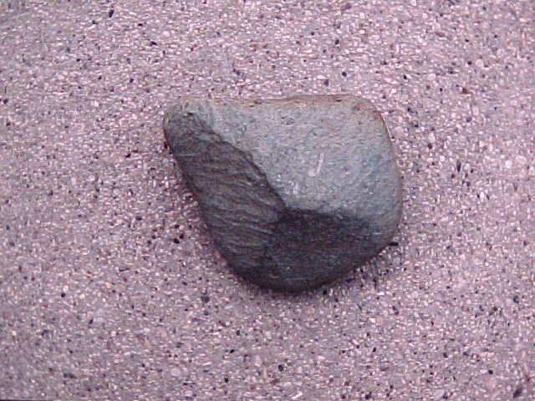
Dreikanter, Wisconsin

Slide 18
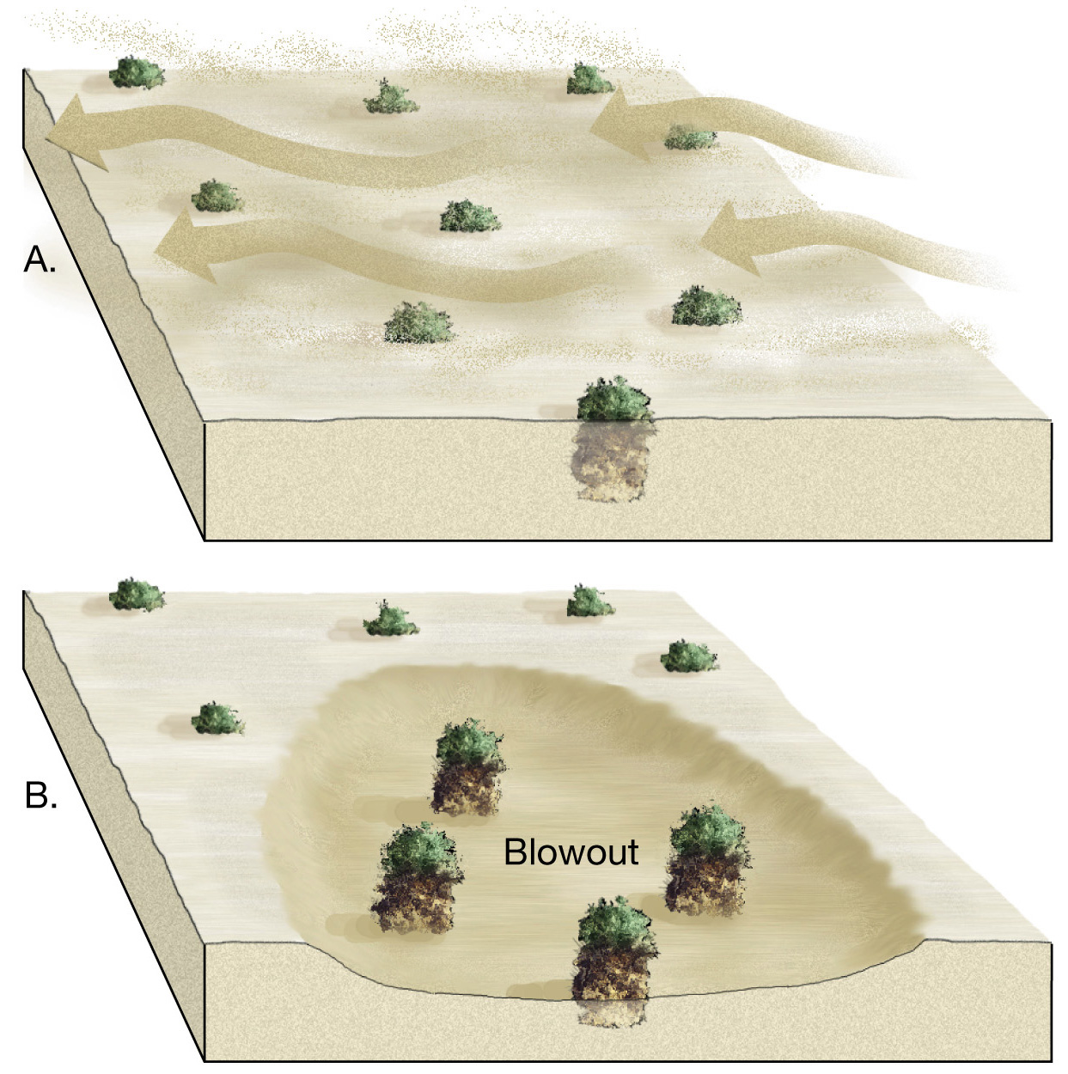
Abrasion

Slide 19
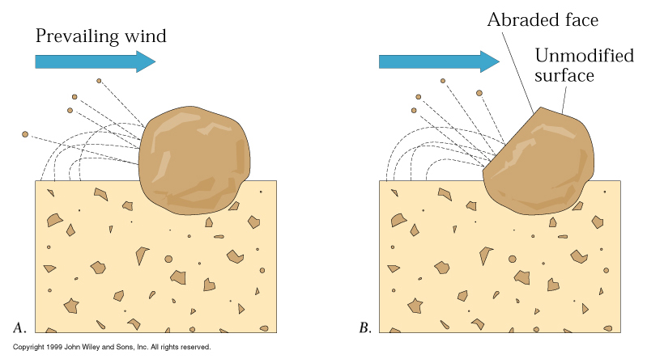
Abrasion – airborne particles chip off small fragments of other rocks.

Slide 20
Transportation of sediment by wind
Differs from that of running water in two ways
Wind is less capable of picking up and transporting coarse materials .
Wind is not confined to channels and can spread sediment over large areas

Slide 21
Sediment Transport
Wind is not as effective at moving particles as is water
Viscosity of air is 17.6 * 10⁻³ mPa-s
Viscosity of water is 1 mPa-s
Wind must overcome resisting forces
Weight of grains
Cohesion between grains

Slide 22
Mechanisms of wind blown grains Geologists usually define rock particles by their size in diameter measured in millimeters, from the largest at 2.0 millimeters to the smallest, at 0.1 millimeters
Saltation – skipping and bouncing along the surface. About 20 to 25 % of the sand transported in a sandstorm is moved this way.
2.Creep or rolling When the largest sized particles can not picked up by the wind. However, the strikes by smaller particles transfer energy thereby moving them forward

Slide 23
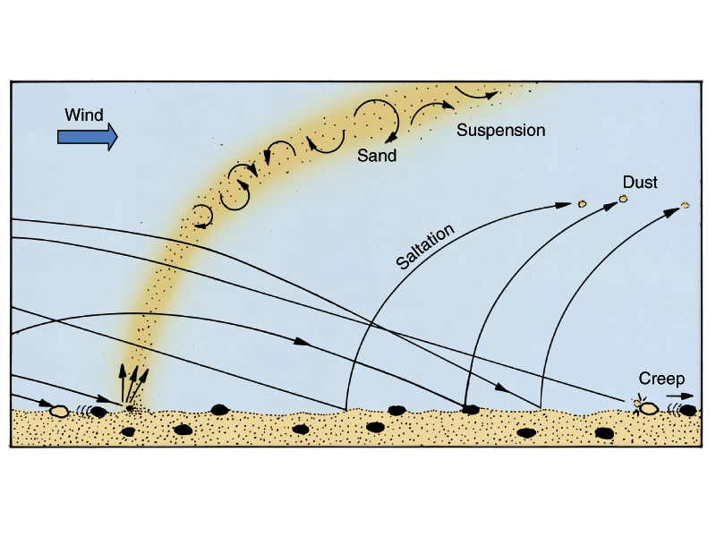
3.Suspended load as clouds of fine, dustlike particles that can rise to altitudes of more than 2 meters (6,560 ft.). In particularly volatile conditions suspended sand particles can result in sandstorms
Wind transportation mechanisms

Slide 24
Sediment size blown by the wind depends on wind speed:
In exceptional wind storms, when wind speeds locally reach 300 km/h or more, coarse rock particles up to several centimeters in diameter can be lifted to height of a meter or more.
In moist regions, where wind speed rarely exceeds 50 km/h, the largest particles of sediment that can be suspended in the air stream are grains of sand.

Slide 25
At lower wind speeds, sand moves along close to the ground surface, and only finer grains of dust move in suspension.
If a wind blows across a bed of sand, the grains begin to move when the wind speed reaches about 4.5 m/s (16 km/h).

Slide 26
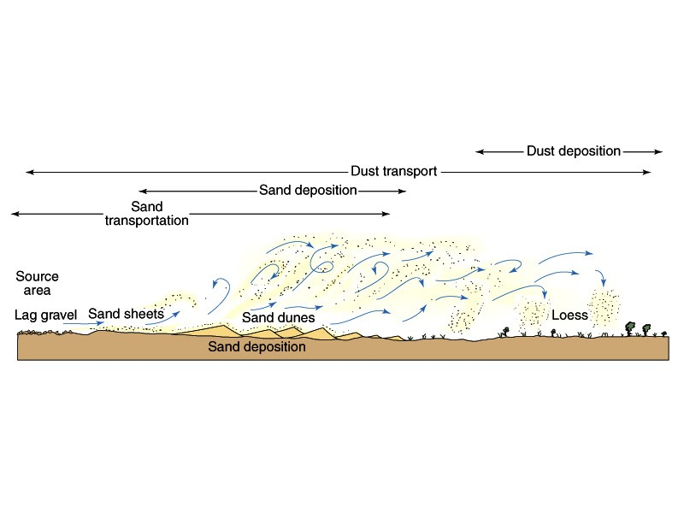
Geological processes in deserts

Slide 27
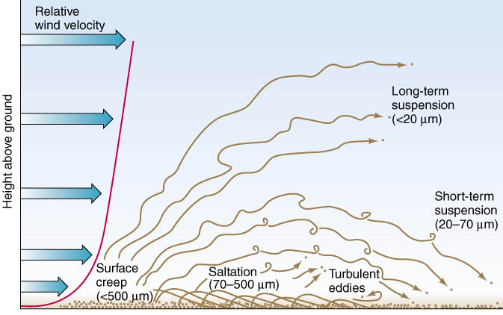

Slide 28
With increasing wind speed, turbulence lifts moving sand grains into the air: this is saltation.
Saltation accounts for at least three-quarters of the sand transport in areas covered by sand dunes.
Sheets of well-sorted sand that have accumulated on the land surface are unstable.

Slide 29
Saltation moves the smaller, most easily transported grains.
Sand grains too large to be moved are left behind.
The coarse grains form a series of small, linear ridges of sand called sand ripples.

Slide 31
